Slide 1
GROUP 1 SNEAKER SHOP

Slide 2
Who We Are
Group Member
Nguyen Ha Vy
Nguyen Son Ngoc
Nguyen Anh Tai
Phan Thanh Nam
Tutorial Lecturer
Hoang Duc Quang
We wish to say a special thanks to
Mr.Hoang Duc Quang, my classmate and FPT Aptech Computer Education.

Slide 3
1.
CUSTOMER BENEFITS
Let’s see the convennience of the customer when using the website

Slide 4
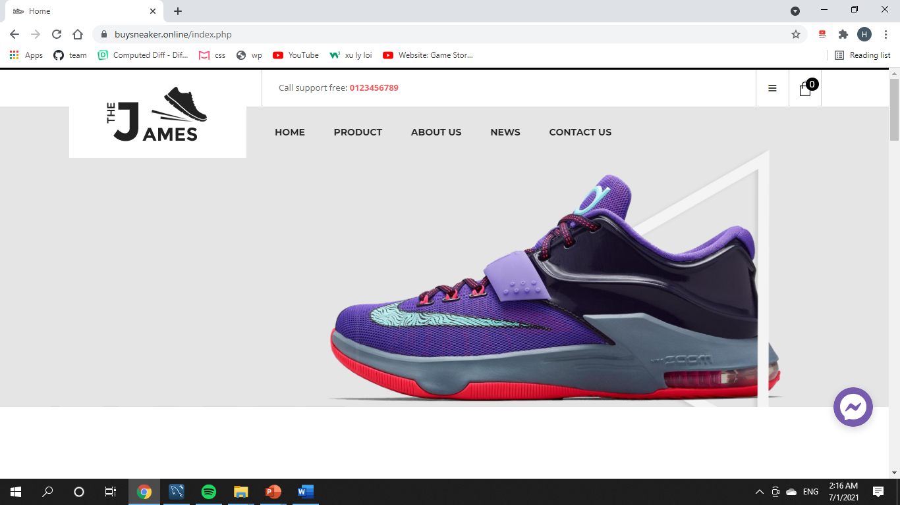
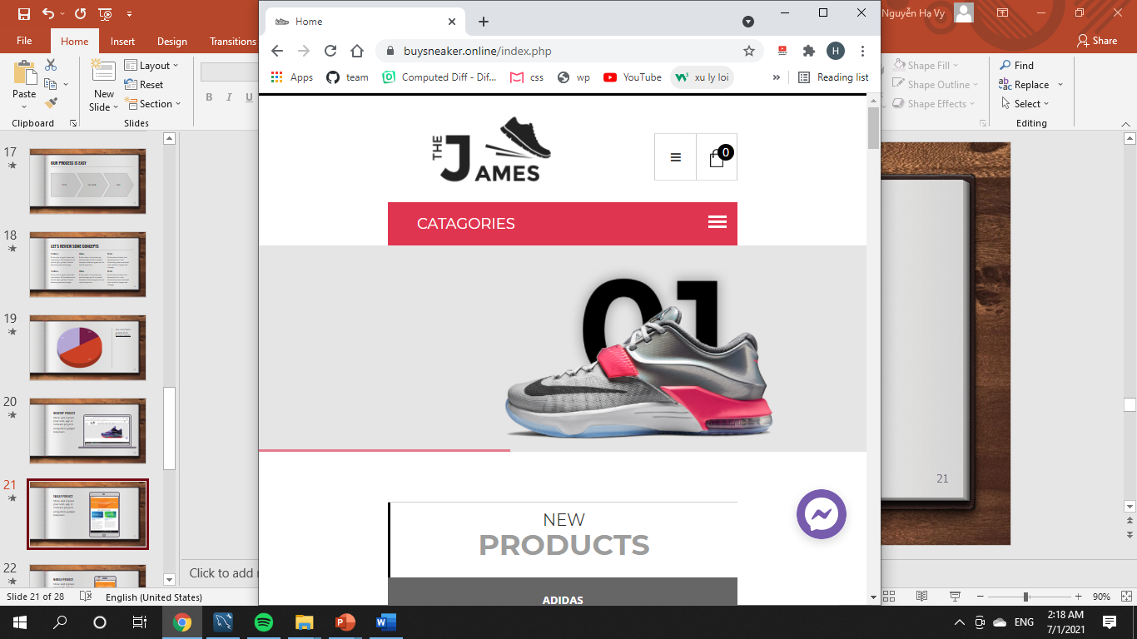
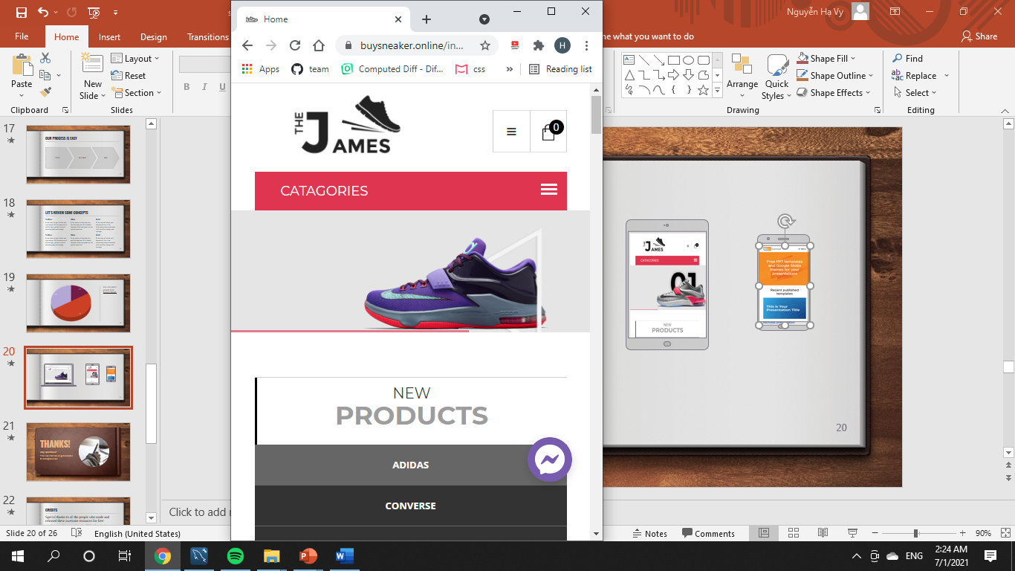
Responsive on all device

Slide 5
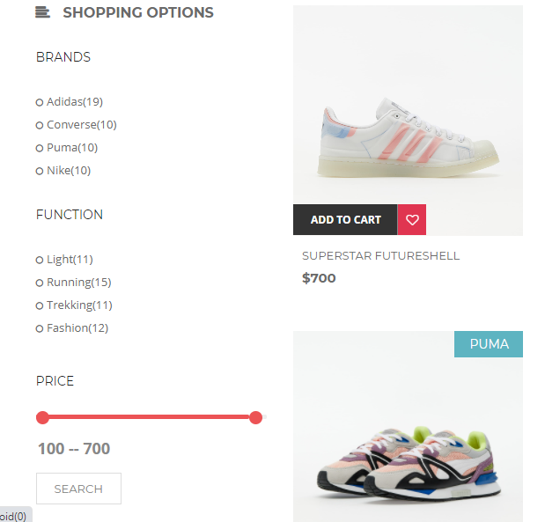

Easy to search!
Search products
Customer can search for products according to their needs with just 1 click!

Slide 6
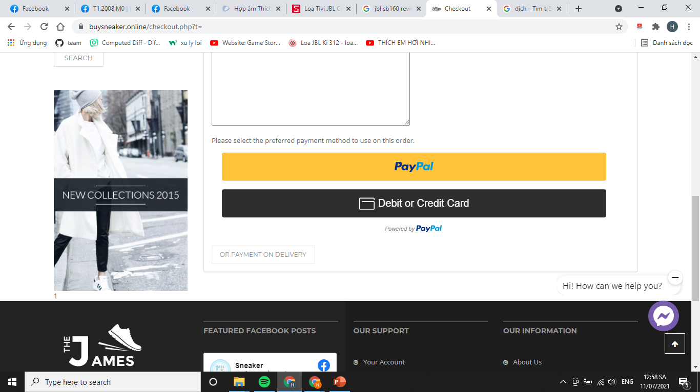
Payment in many ways
Search products
Customer can search for products according to their needs with just 1 click!

Slide 7
2. BUSINESS BENEFITS
Let’s see the convenience of the business when using the website

Slide 8
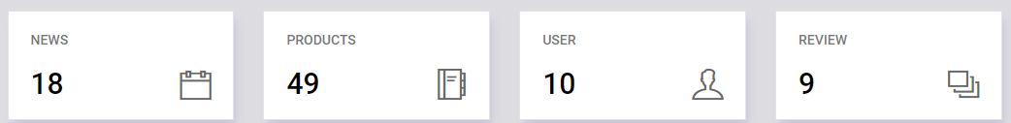
89,526
185,2 users
457
That’s a lot of news
And a lot of users
Order success!
USING DATA FOR STATISTICS

Slide 9
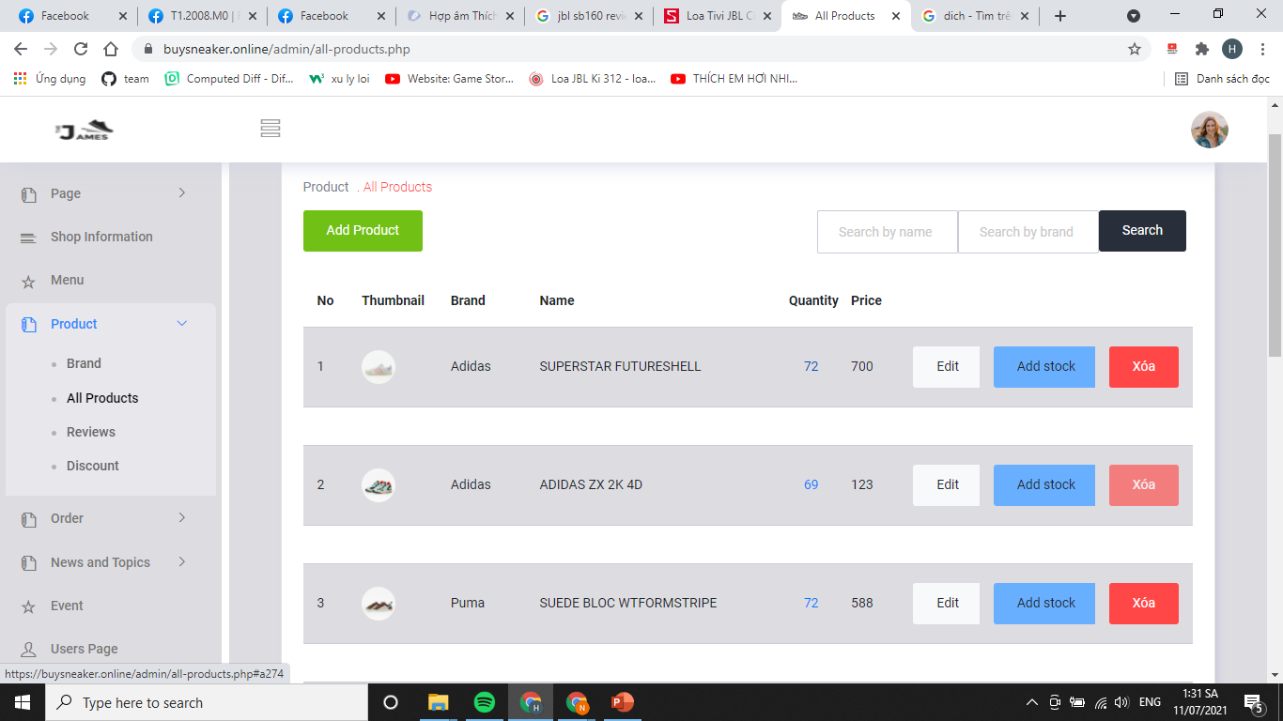
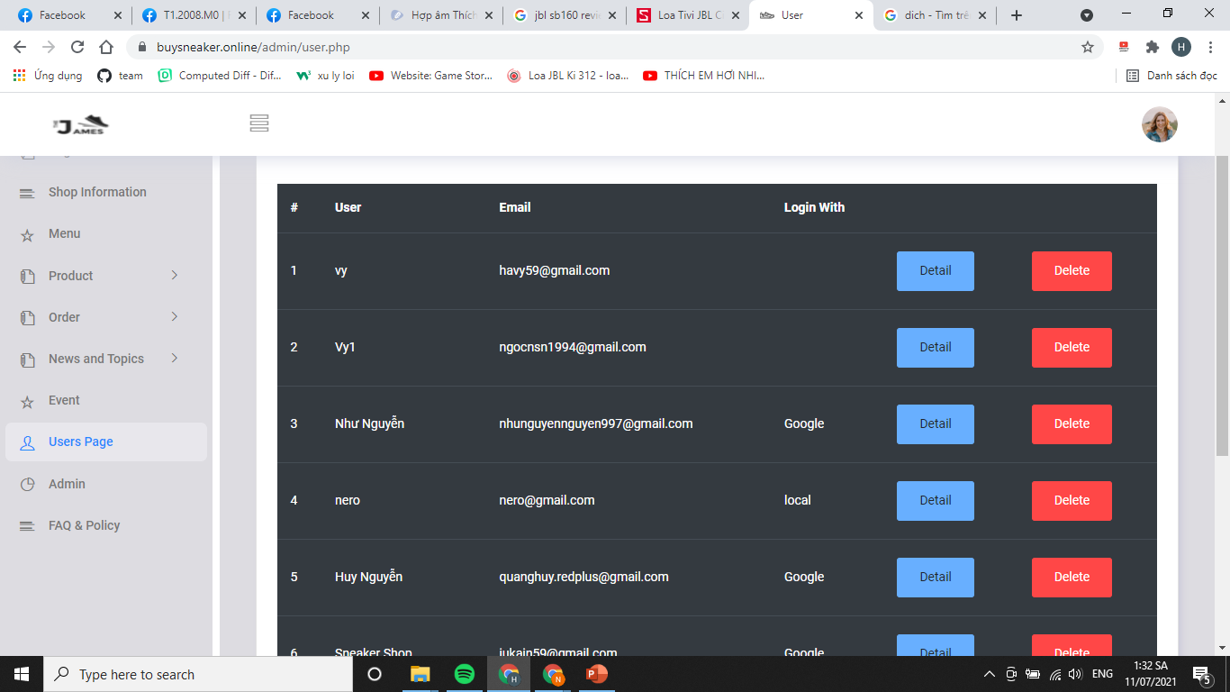
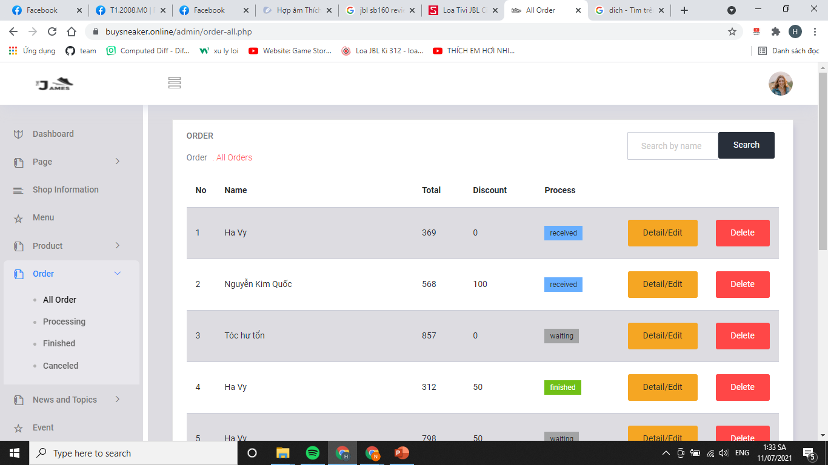
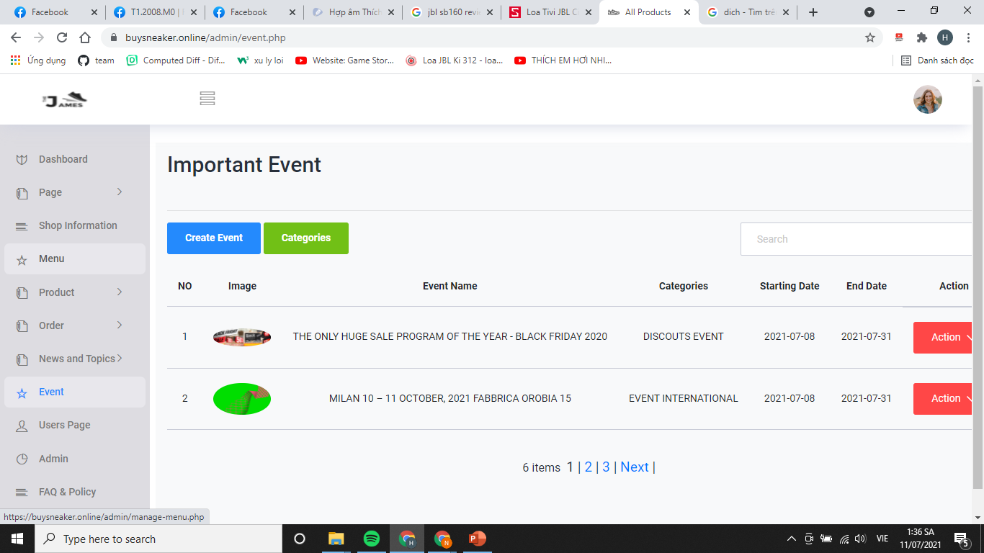
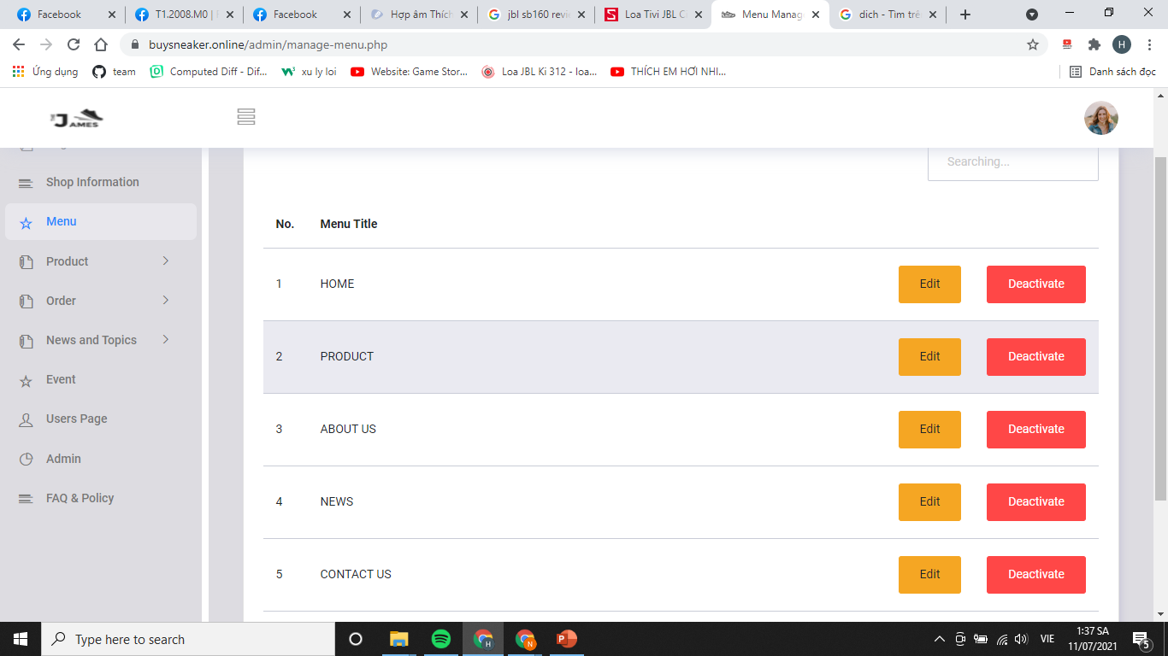
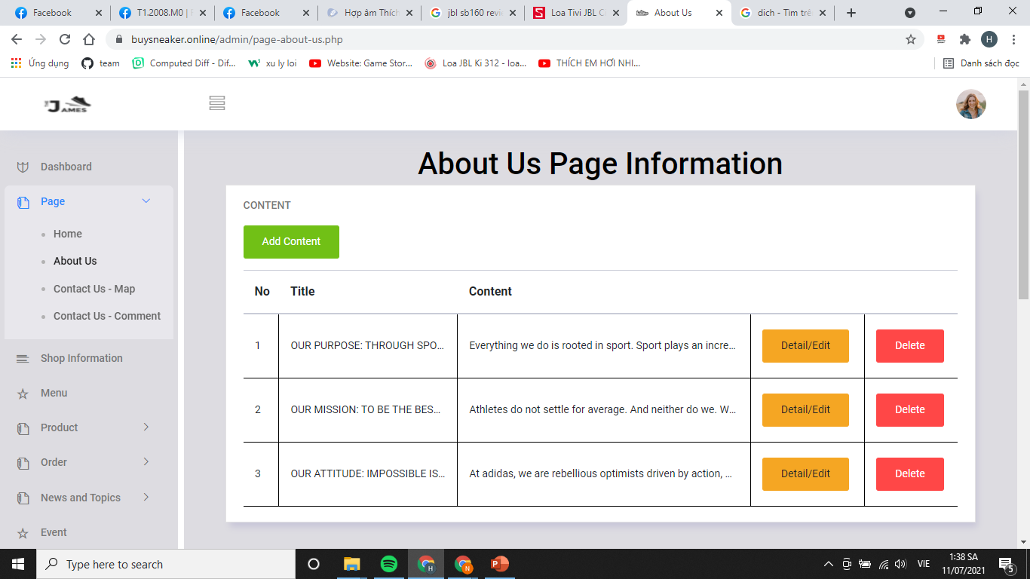
Business can manage …
Products
User
Order
Event
Menu
Pages

Slide 10
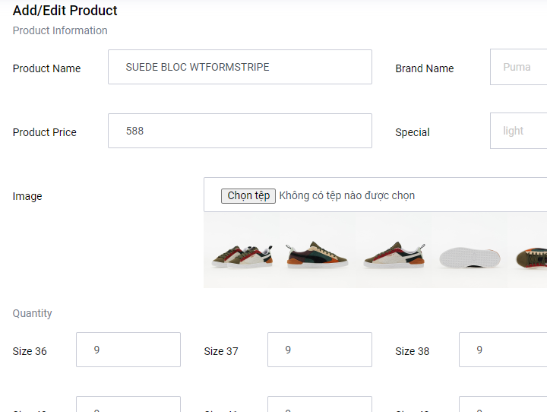
Easy to use management functions
Business can easily view, add, edit or delete information.

Slide 11
ORDER PROCESS IS EASY
waiting
received
delivering
finished

Slide 12
Task Sheet
No. | Task | Made by
1 | Login, User, Product, Order, Menu, Box chat | Hạ Vy
2 | News, FAQ&Policy, Admin | Sơn Ngọc
3 | Wishlist, Review filter, About us | Anh Tài
4 | Contact Us, Event | Thanh Nam

Slide 13
THANKS!

